Slide 1
DSI - Capstone Project
Quora Insincere Questions
Ruoran Huang

Slide 2


Internet is the new wild west

Slide 3
What is Quora?
What they do - Crowdsourcing Q&A website.
Number of visitors - 300 million unique users per month.
Data generated - 30 million questions in the last 2 years, plus answers.
Value - $1.8 billion, estimated

Slide 4

“An existential problem for any major website today is how to handle toxic and divisive content”

Slide 5
The Quora Problem
Insincere Questions - those founded upon false premises, or that intend to make a statement rather than look for helpful answers
Data Set
1.31million questions.
6.2 % classified as Insincere
Objective
Correctly Identify insincere questions in the data set.

Slide 6


Most Common Words
Sincere
Insincere

Slide 7

Bag of Words Model
Model
Count Frequency of words
Ignore order/context
Assign sincerity value to each word
Determine sincerity as a average value of words
Controls
Word selection
Single words and/or word phrases
Relative word frequency
Replace words with common words (Identity label)
Correctly identified 69% of insincere questions.
Incorrectly identified 5% of sincere questions.

Slide 8
LSTM Model
Model
Assign complex meaning to each word
Consider order and context
Able to ignore meaningless words automatically.
Determine sincerity based on complex interaction of word meaning
Controls
Size of vocabulary
Complexity of meaning
Number of adjacent words to consider
Correctly identified 56% of insincere questions.
Incorrectly identified 2% of sincere questions.
*https://towardsdatascience.com/illustrated-guide-to-lstms-and-gru-s-a-step-by-step-explanation-44e9eb85bf21

Slide 9
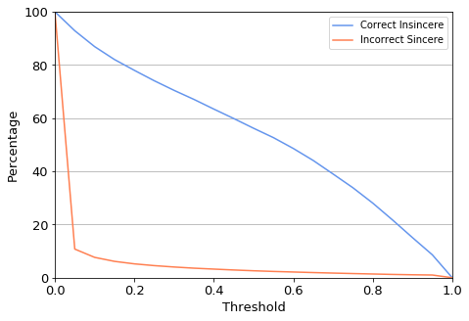
Focus what is important
What is our priority?
Default model result can be changed to priority what is important.
Increase capture rate of Insincere questions
Or reduce amount of manual review.
Prioritise capture of insincere questions
Bag of Words
Correctly identified 82% of insincere questions.
Incorrectly identified 10% sincere questions.
LSTM
Correctly identified 86% of insincere questions.
Incorrectly identified 8% of sincere questions.
LSTM Threshold

Slide 10
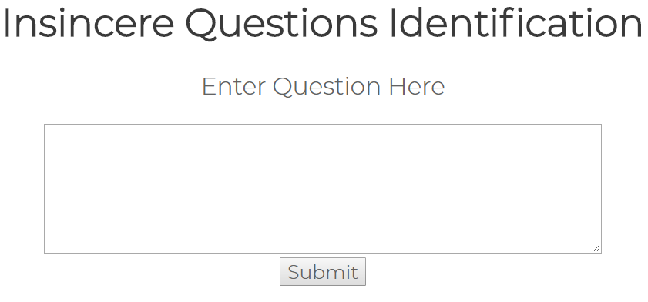
Demonstration

Slide 11
Summary
My Machine learning model is capable greatly reduce the number of questions needing manual review (by 87%).
Some insincere questions will be missed, this is unavoidable, where websites will need to rely on user reporting.
There are many more optimising opportunities for the model, further improvement in accuracy is possible.
.

Slide 12

Questions?

